Slide 1




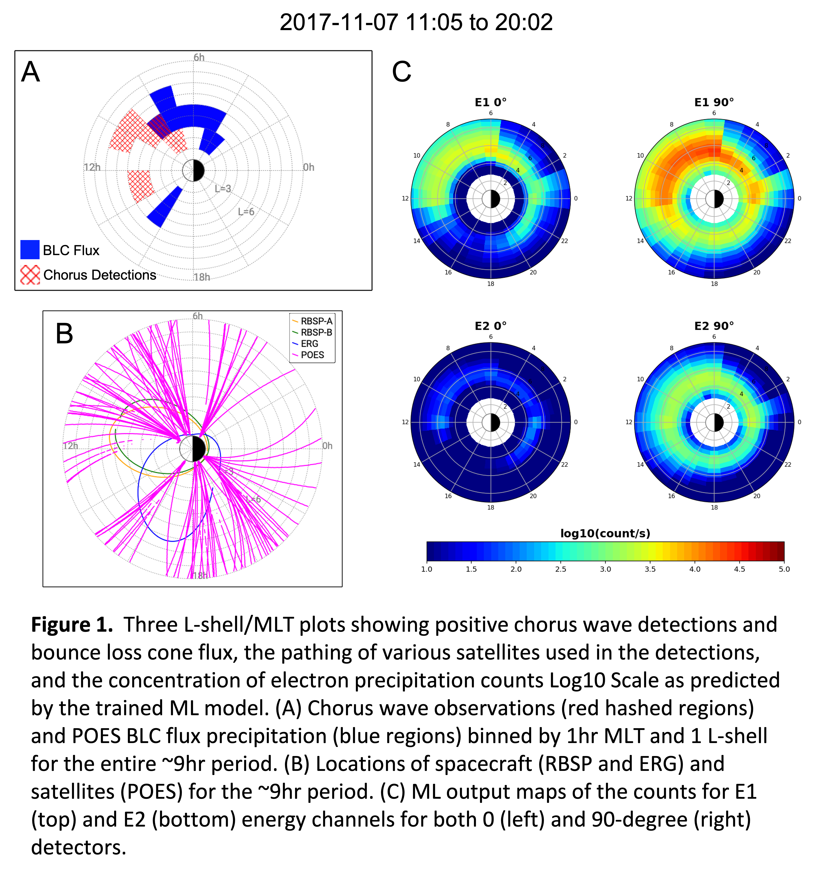
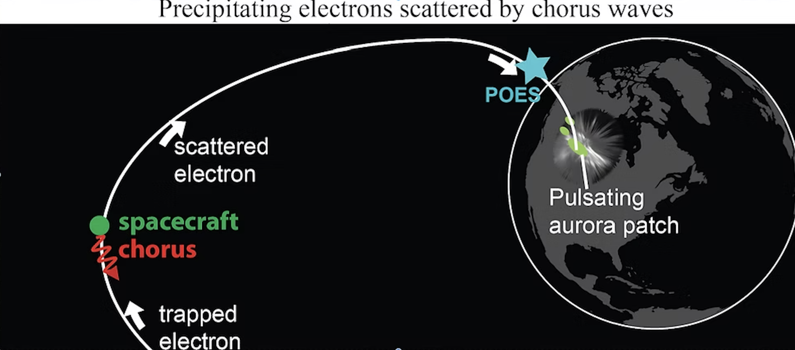
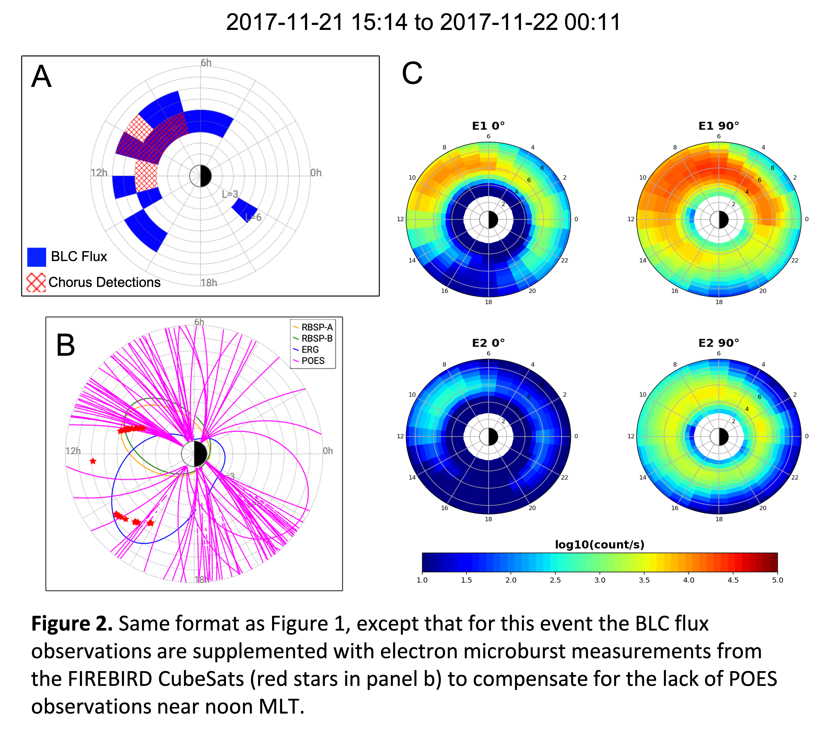
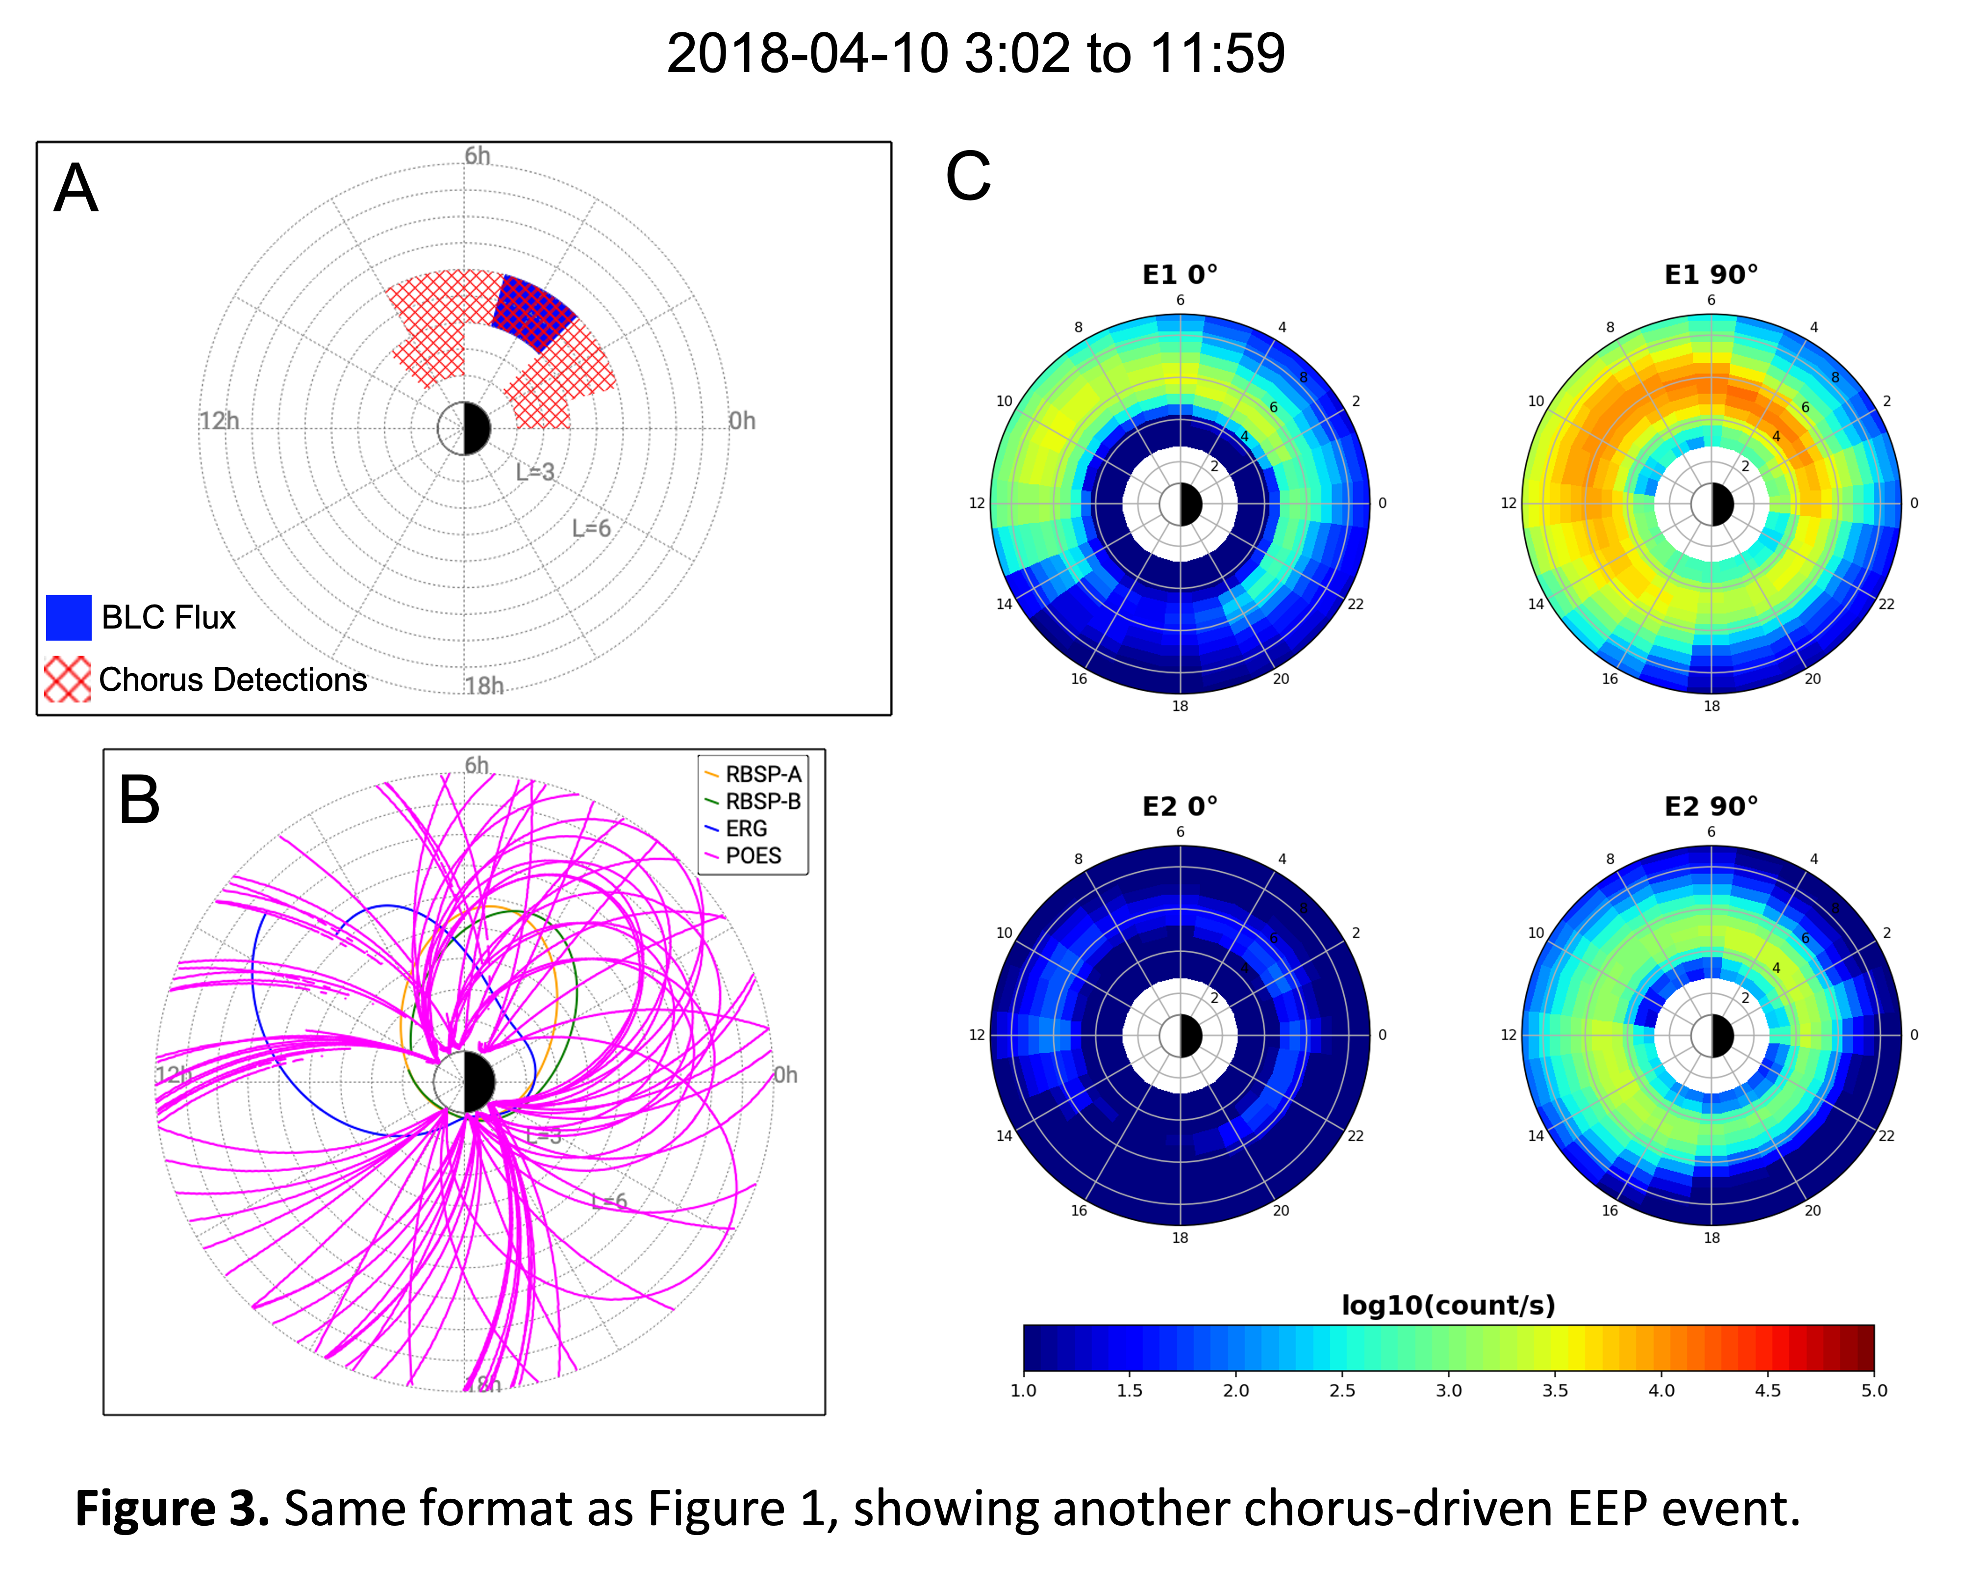
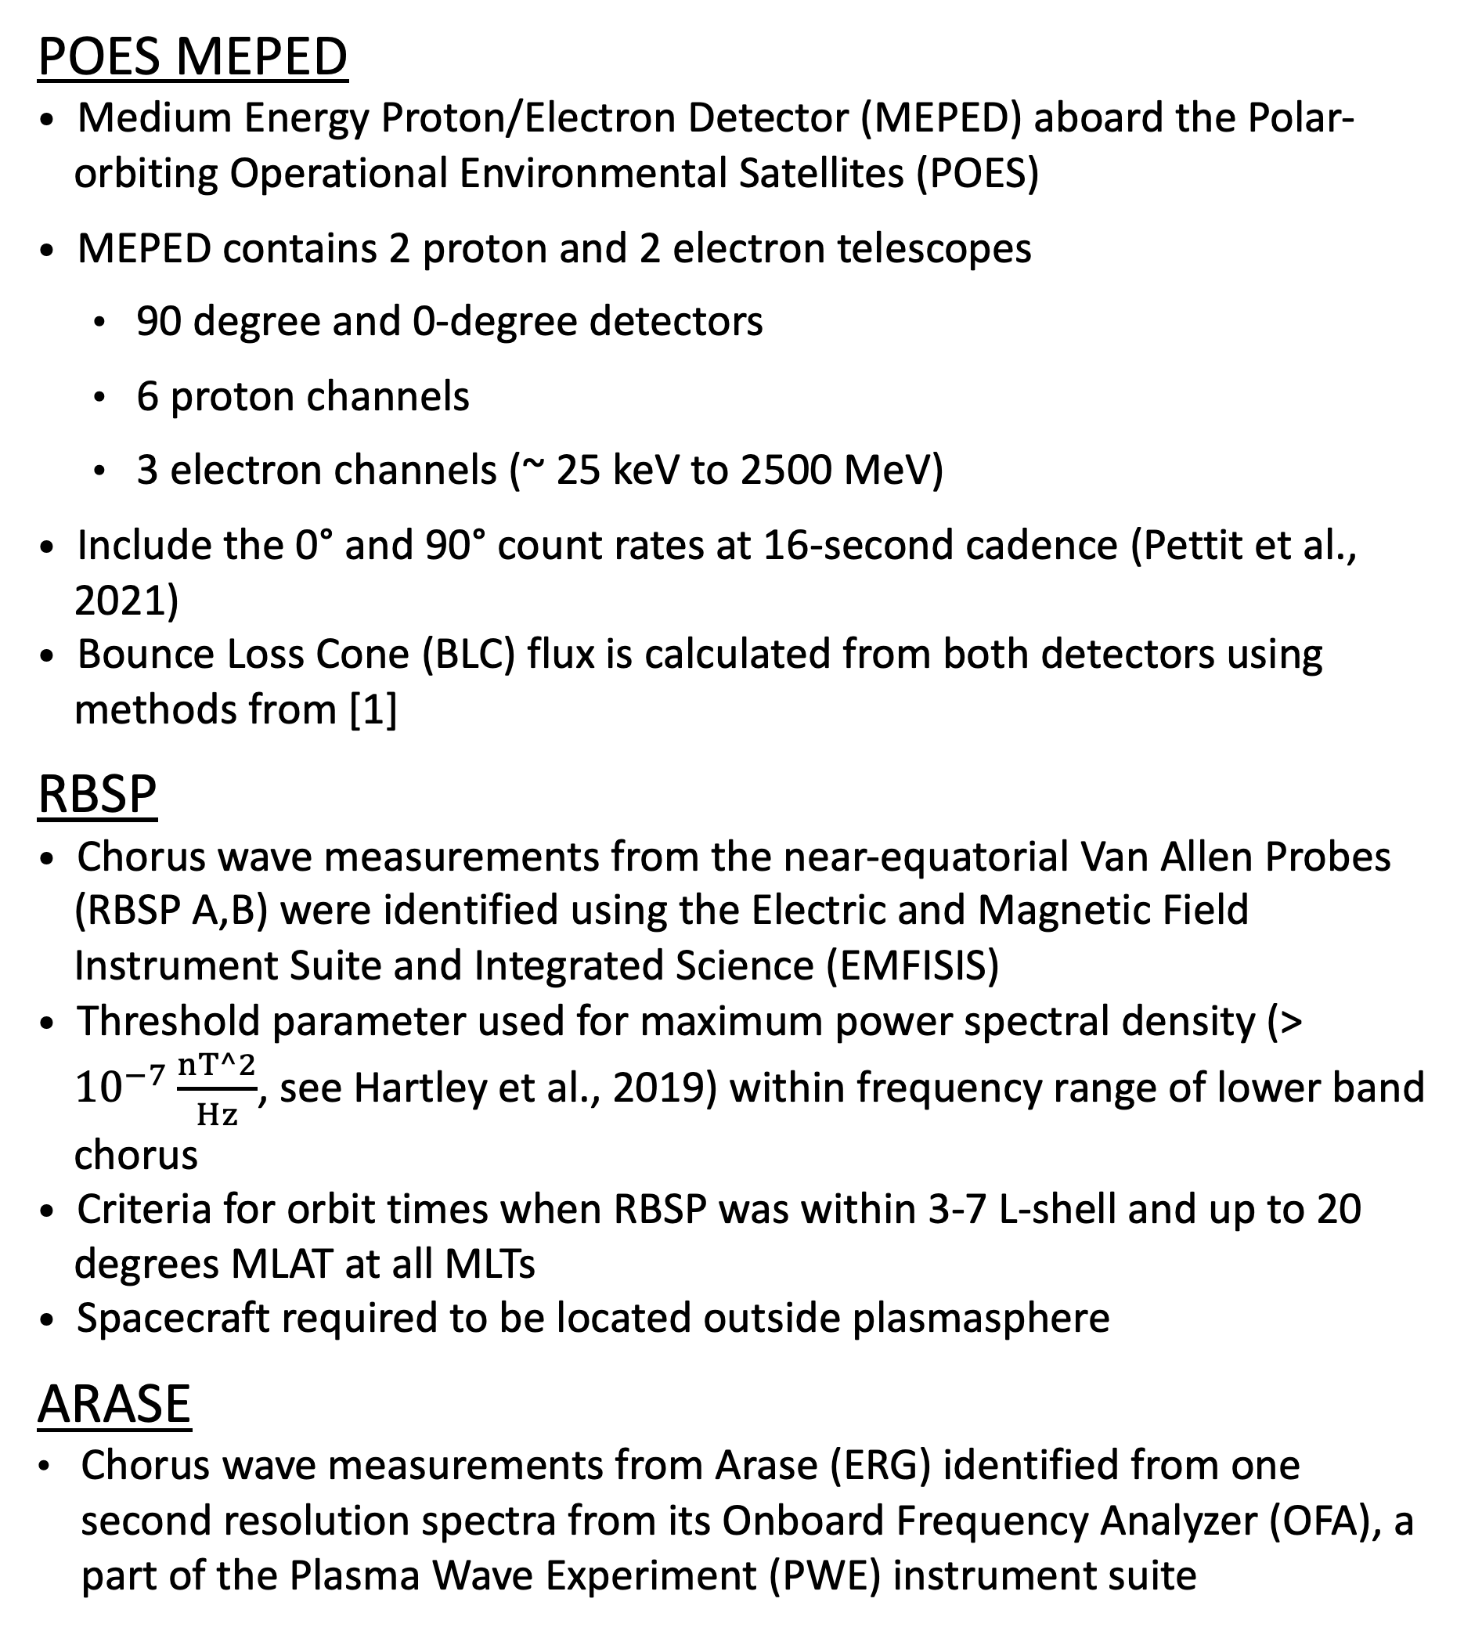
SM31C-2380
Using Machine Learning for Estimating Chorus Wave Energetic Electron Precipitation
Alexander Bibeau¹, Joshua Pettit^{1,2}, Sadie Elliott³, Justin Morales¹, Luisa Capannolo⁴
⁽¹⁾George Mason University, ⁽²⁾NASA Goddard, ⁽³⁾University of Minnesota, ⁽⁴⁾Boston University
Introduction and Motivation
MAPLE (MAPs of LEO Electrons) ML Model
Chorus waves and electron precipitation are two phenomena deeply entwined. Chorus waves are generated by wave‑particle instabilities driven by anisotropic pitch‑angle distributions of energetic electrons, which cause the waves to grow through resonant interactions. When these chorus waves scatter electrons into the bounce loss cone, the precipitating particles deposit energy in the upper atmosphere producing auroral emissions and influencing atmospheric chemistry. Due to the temporal and spatial extent of chorus waves and their resulting precipitation, they have been historically difficult to constrain and understand the temporal evolution. Data from RBSP and ARASE (ERG) can be used to detect chorus wave events and data from the POES MEPED detectors can be used to detect the resulting precipitation at LEO altitudes. However, this method is constrained due to the recent decommissioning of the POES MEPED data. To circumvent this, we present a machine learning model called MAPLE (MAPs of LEO Electrons) that attempts to recreate the POES MEPED count rates. We show three chorus wave events and investigate how well the new ML model can reproduce the precipitation patterns.
The MAPLE model is a Deep Neural Network Machine Learning model that creates count rate maps of electrons at 1-min resolution
The ML model is trained on POES MEPED data from 2003 through 2014 along with SuperMAG regional indices, l-shell and MLT.
All data is cleaned and binned into weighted, 1-minute averages for model ingestion
Please see Justin Morales’ Poster at SM31F-2415 for all the details on MAPLE
Chorus Wave Events
Figures 1 - 3 present three chorus-driven EEP events, with observations shown in panel a, spacecraft/satellite locations shown in panel b, and ML model map outputs shown in panel c
Panels a show binned data maps as binary yes/no detections of chorus and BLC flux (see [2])
Figure 1:
  Region of continuous BLC flux between 4 and 9 MLT, with another smaller region around 15 MLT. Chorus waves are observed between MLTs of 7 and 14 (Figure 1a)
  Large gaps in POES observations around 0-4 MLT , 6 MLT, and 12-15 MLT (Figure 1b)
  Continuous precipitation for a wide range of L shells from 6 to 12 MLT, with a narrower region around 0 to 6 MLT (Figure 2c)
Figure 2:
  Large region of BLC flux observations between 4 and 16 MLT, with wider (in L) of both BLC flux and chorus waves from 7 to 13 MLT, with narrower regions from 4-6 (lower L) and 14-16 (higher L) MLT (Figure 2a) - consistent with ML maps (Figure 2c)
  Large gap around noon MLT in POES, which has been supplemented by FIREBIRD CubeSat microburst observations (red stars, Figure 3b)
Figure 3:
  Narrow region of chorus and BLC flux concentrated around 0 to 8 MLT (Figure 3a)
  Large gaps in POES data from 6 to 14 MLT (Figure 3b)
  ML model maps show precipitation in the same region as observations, but a more continuous region from 8 to 12 MLT (Figure 3c)
  Although Arase collected data between 6 and 14 MLT during the period (see Figure 3b), chorus waves were not observed but are observed on the second pass through this region - observations cannot capture temporal evolution
Should be noted that just because we do not observe chorus and/or BLC flux in a region does not discount the possibility of their occurrence due to their temporal evolution and limited observations
Methodology and Data
POES MEPED
Medium Energy Proton/Electron Detector (MEPED) aboard the Polar-orbiting Operational Environmental Satellites (POES)
MEPED contains 2 proton and 2 electron telescopes
  90 degree and 0-degree detectors
  6 proton channels
  3 electron channels (~ 25 keV to 2500 MeV)
Include the 0° and 90° count rates at 16-second cadence (Pettit et al., 2021)
Bounce Loss Cone (BLC) flux is calculated from both detectors using methods from [1]
RBSP
Chorus wave measurements from the near-equatorial Van Allen Probes (RBSP A,B) were identified using the Electric and Magnetic Field Instrument Suite and Integrated Science (EMFISIS)
Threshold parameter used for maximum power spectral density (> ${10}^{−7}\frac{nT^2}{Hz}$, see Hartley et al., 2019) within frequency range of lower band chorus
Criteria for orbit times when RBSP was within 3-7 L-shell and up to 20 degrees MLAT at all MLTs
Spacecraft required to be located outside plasmasphere
ARASE
Chorus wave measurements from Arase (ERG) identified from one second resolution spectra from its Onboard Frequency Analyzer (OFA), a part of the Plasma Wave Experiment (PWE) instrument suite
Results
Two out of the three events show good agreement with the ML model output
April 10th data shows narrow region of precipitation and chorus while ML model shows a more extended region - likely due to temporal evolution of chorus/precipitation and limited observations from the data, this is consistent with time series Arase data
Global coverage of in situ observations is scarce, limiting our understanding of chorus-driven precipitation
Our results illustrate our ML model’s ability to accurately capture EEP associated with chorus wave activity
Conclusions and Future Work
For cases 1 and 2, the MAPLE Model does a reasonable job of replicating what we observed
Future work will compare BLC flux generated from MAPLE using methods in Pettit et al., (2021) to compare directly with chorus wave observations
The MAPLE model is still in development and will continue to improve as time moves forward
References
[1] Pettit+2021: https://doi.org/10.1029/2021JA029667
[2] Elliott+2024: https://doi.org /10.1029/2024ja033208
Acknowledgements
This research is funded by NSF grants: AGS 2401265

